Slide 1

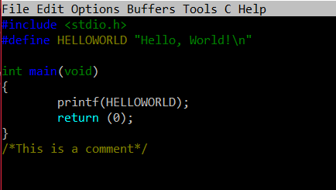
C PROGRAMMING

Slide 2


BASIC STRUCTURE

Slide 3
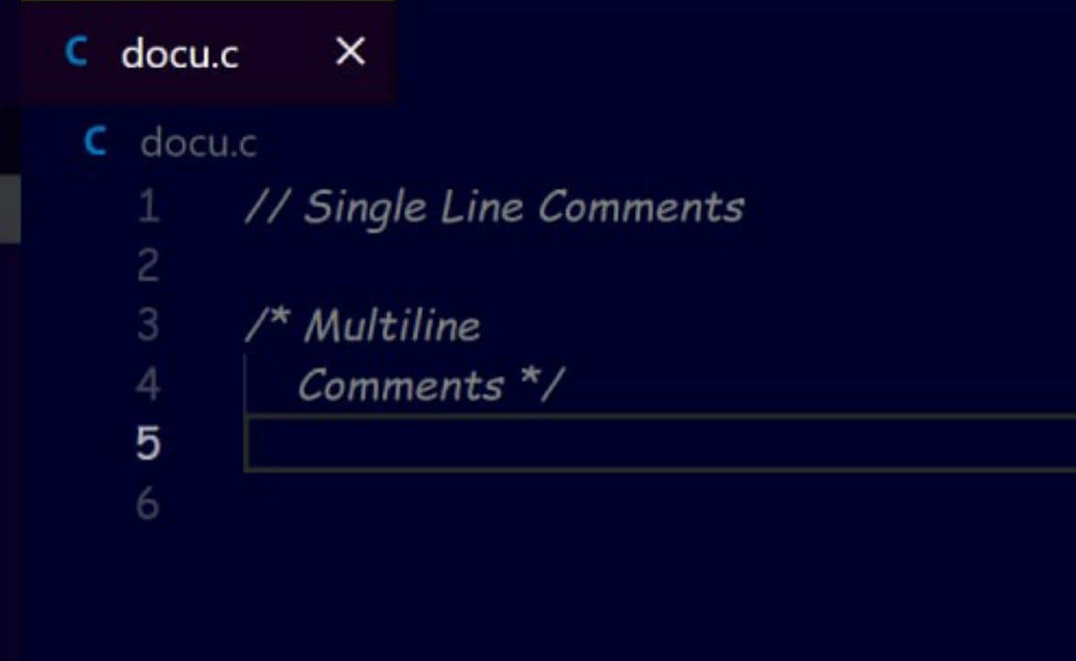
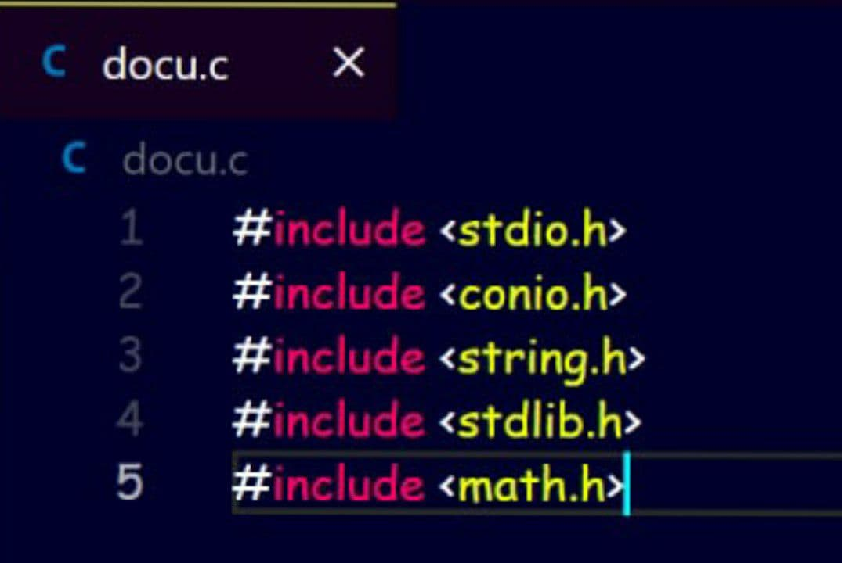
Structure of a C program
1. Documentation section – The document section is the part of the program where the programmer gives the details associated with the program. He usually gives the name of the program. Name of author , date and time.
2. Link Section – The part Of The Code Is Used To Declare All The Header Files That Will Be Used In The Program.

Slide 4
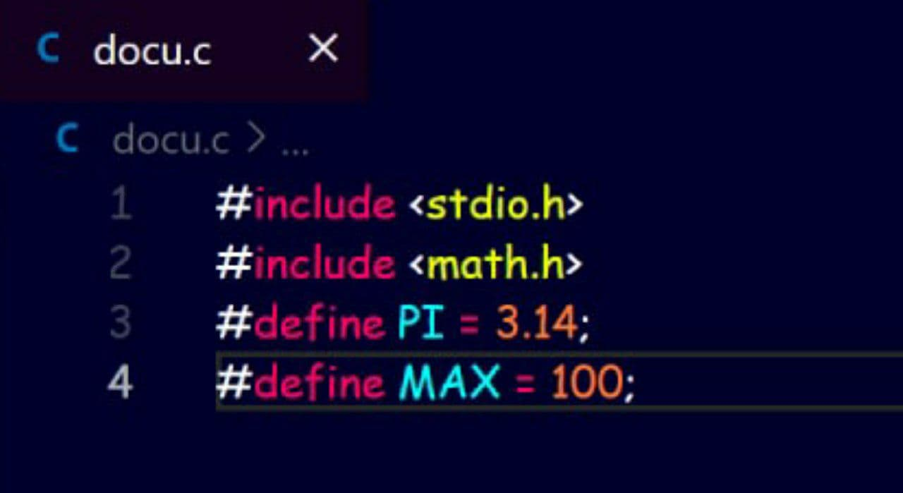
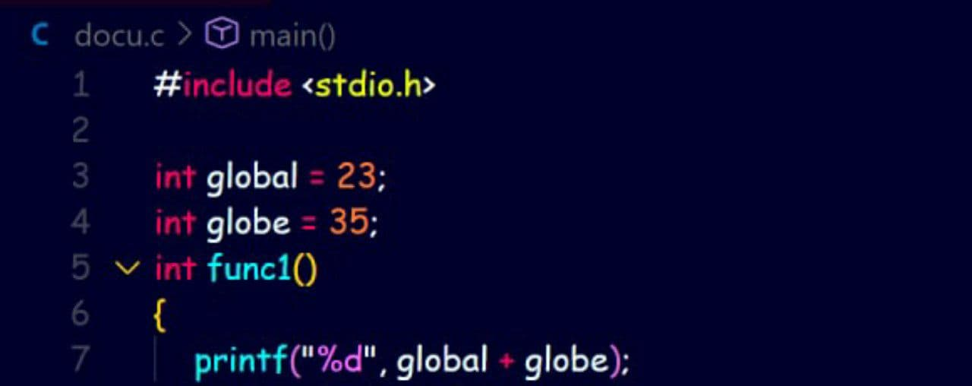
Structure of a C program
3. Definition section – In This Section, We Define Different Constants , The Keywords Define Is Used In The Part.
4. Global Declaration Section – This Part Of The Code Is The Part Where The Global Variables Are Declared. The User – Defined Functions Are Also Declared In This Part Of The Code.

Slide 5
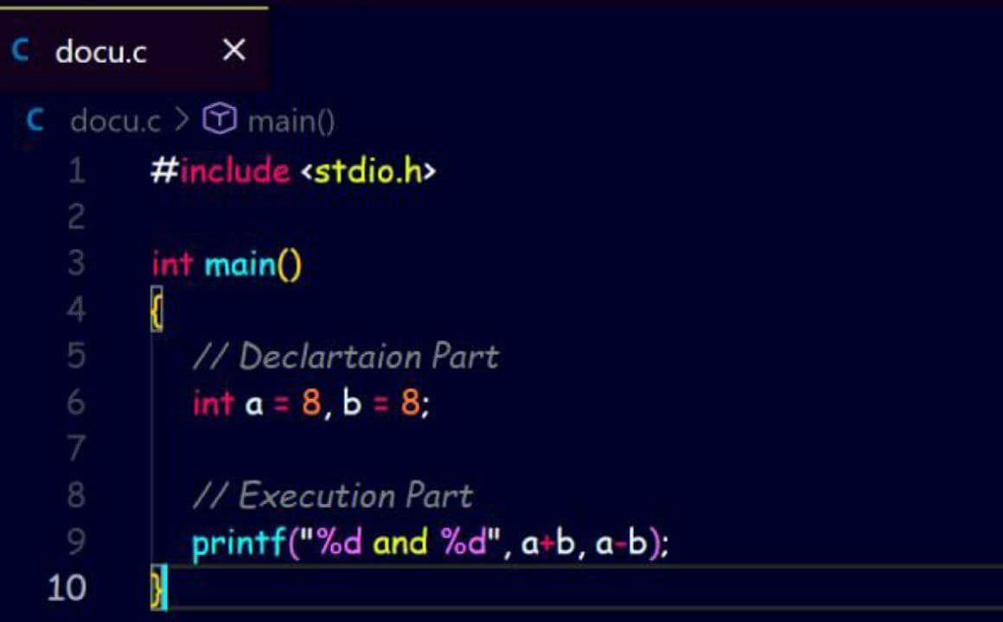
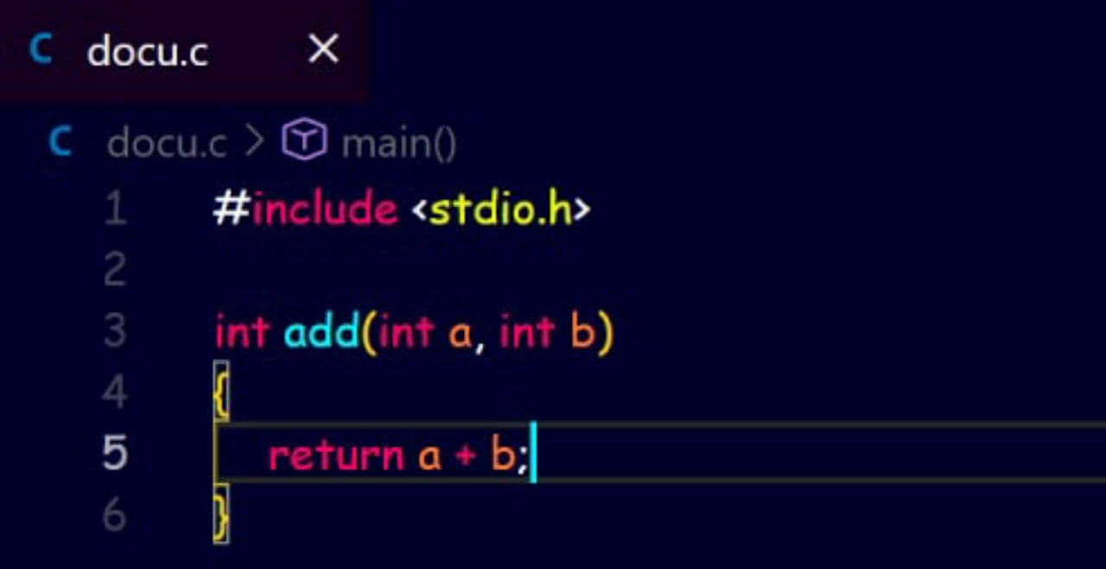
Structure of a C program
5. Main Function Section –Every C Program Needs To Have The Main Function. Each Main Function Contains 2 Part. A Declaration Part And An Execution Part. The Declaration Part Is The Part Where All The Variables Are Declared. The Main Function Is The Entry Point Of The Program.
6. Sub-Program Section – All The User – Defined Functions Are Defined In This Section Of The Program.

Slide 6
